Slide 1

2025 ANNUAL MEMBERSHIP MEETING
LUSO-AMERICAN
EDUCATION FOUNDATION
SATURDAY JANUARY 24, 2026

Slide 2


Moment of Silence
In Memory of our late members.

Slide 3
Roll Call

Slide 4
Reading/Approval of the 2024 Annual Membership Meeting Minutes & Agenda

Slide 5


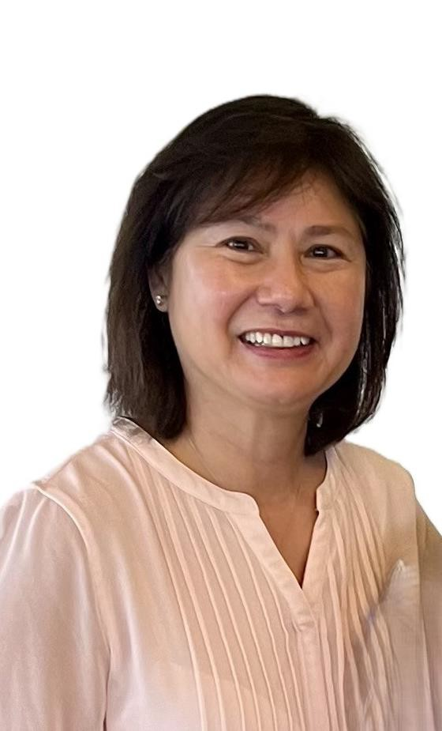
P R E S I D E N T
REPORT FROM L A E F
Maria Roliz
LAEF President

Slide 6
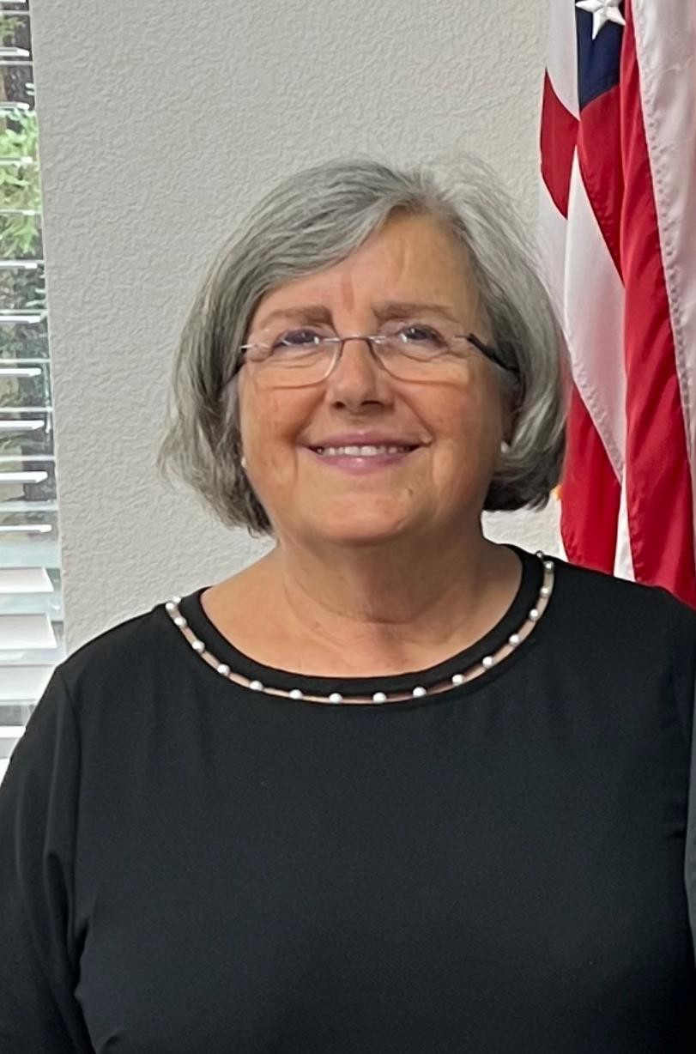
C H A I R M A N
REPORT FROM L A E F
Deolinda Adao
LAEF Chairman

Slide 7
APPOINTMENT OF NOMINATING & RESOLUTION COMMITTEES
Maria Roliz
LAEF President

Slide 8
REPORT OF THE NOMINATING COMMITTEE
Nominees - Director:
TBD
Nominating Committee
Arnold Rodrigues – Chair
Nominations to be taken from floor.

Slide 9
REPORT ON EDUCATION
Nancy Cardoso
Vice-President of Education
2025 Scholarships Awarded
2026 Scholarships and Grants Application
Deadline March 1, 2026
2026 Youth Cultural Summer Camp

Slide 10
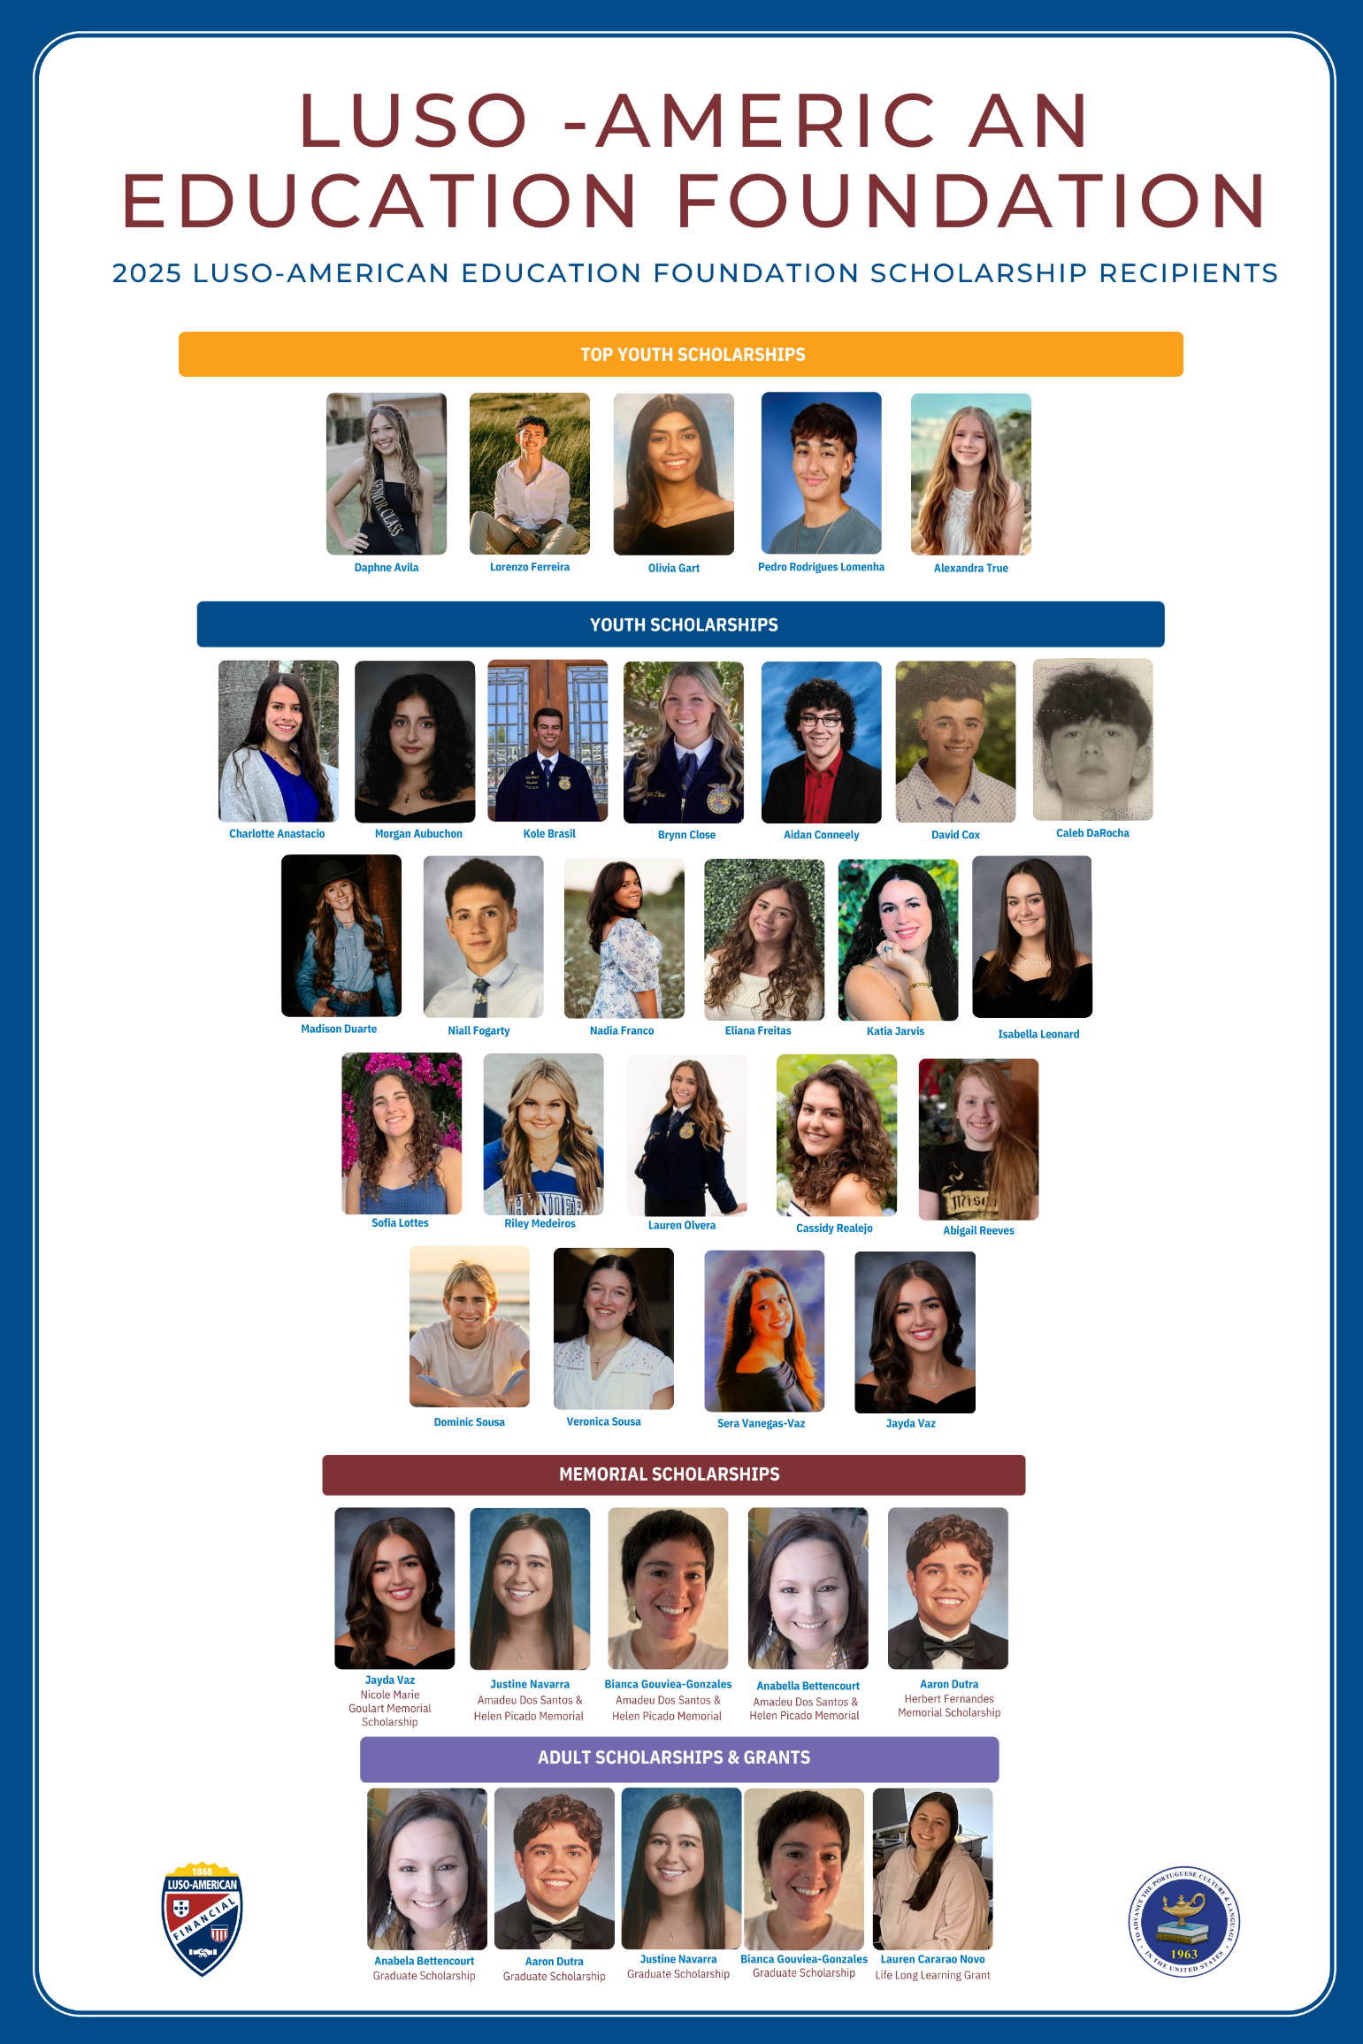
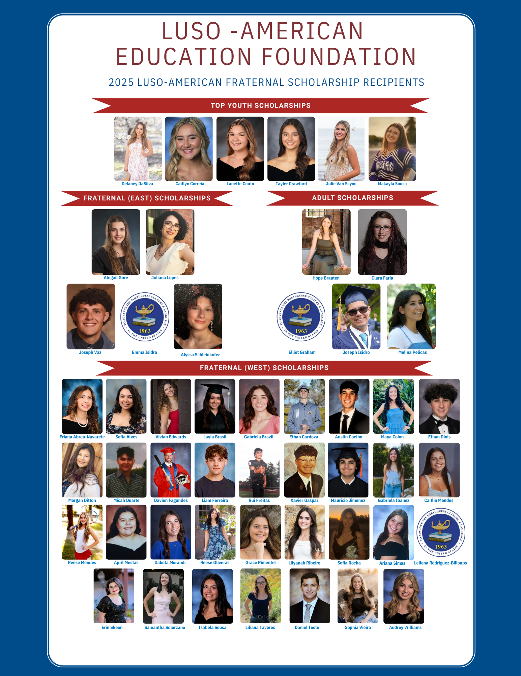
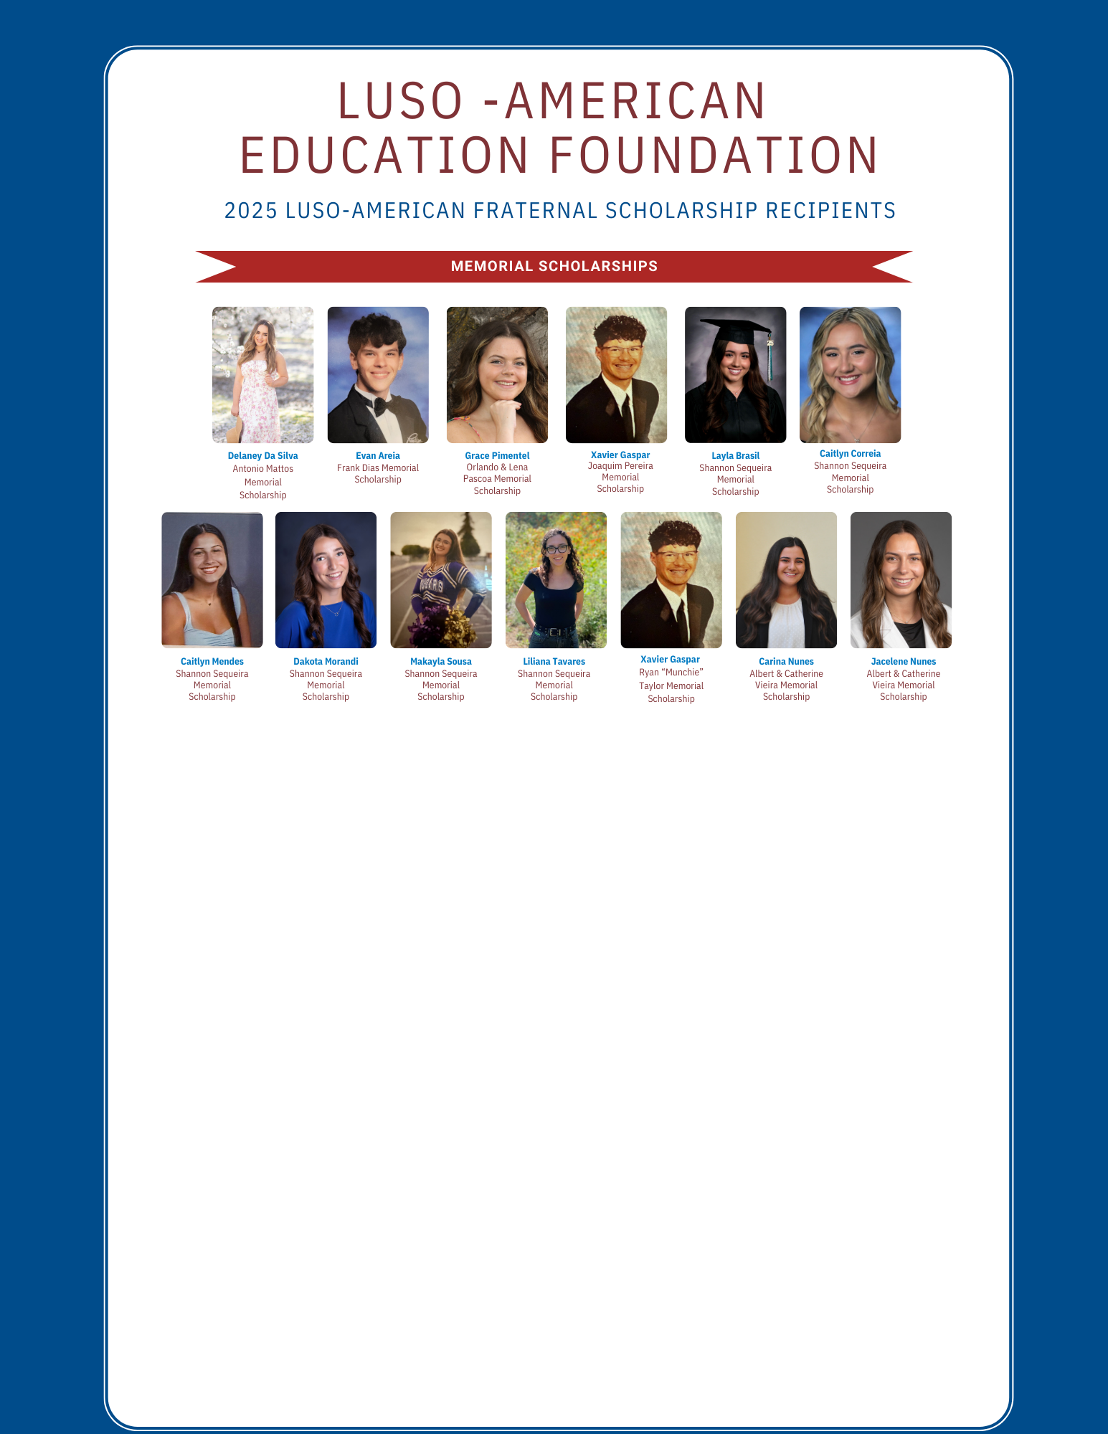

Slide 11




SCHOLARSHIPS & GRANTS TOTAL
$58,000.00
$142,300.00
$200,300.00

Slide 12
2025 SCHOLARSHIPS & GRANTS
2025 Scholarships & Grants Awarded | Total Amounts Awarded
Luso-American Fraternal Youth Scholarships | $115,000.00
Luso-American Fraternal 20-30’s Scholarships | $5,000.00
Luso-American Fraternal PCU Scholarships | $8,500.00
Luso-American Fraternal Memorial Scholarships | $13,800.00
Total Luso-American Fraternal Amount Awarded |  | $142,300.00
Luso-American Education Foundation Youth Scholarships | $40,000.00
Luso-American Education Foundation Adult Scholarships | $2,500.00
Luso-American Education Foundation Adult Grants | $7,000.00
Luso-American Education Foundation Memorial Scholarships | $8,500.00
Total Luso-American Education Foundation Amount Awarded |  | $58,000.00
Total Amount Awarded |  | $200,300.00

Slide 13

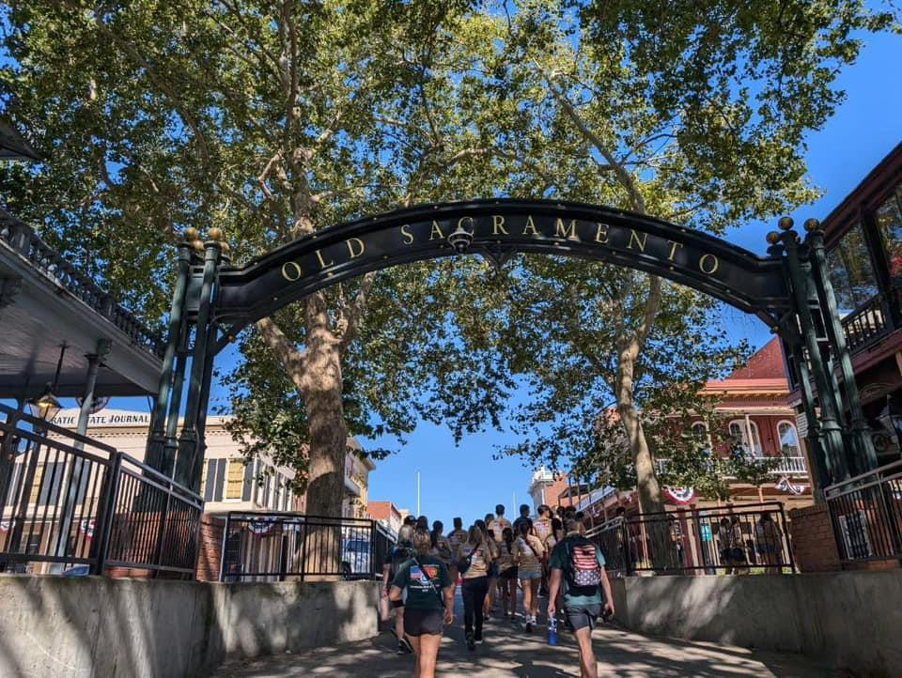
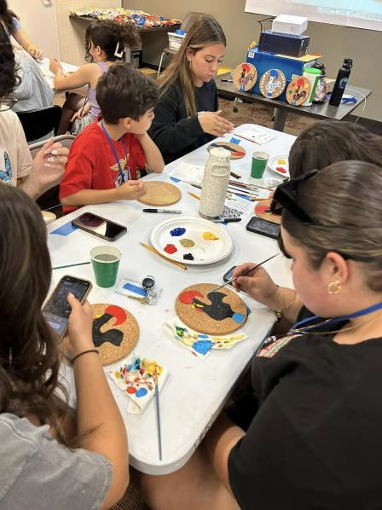
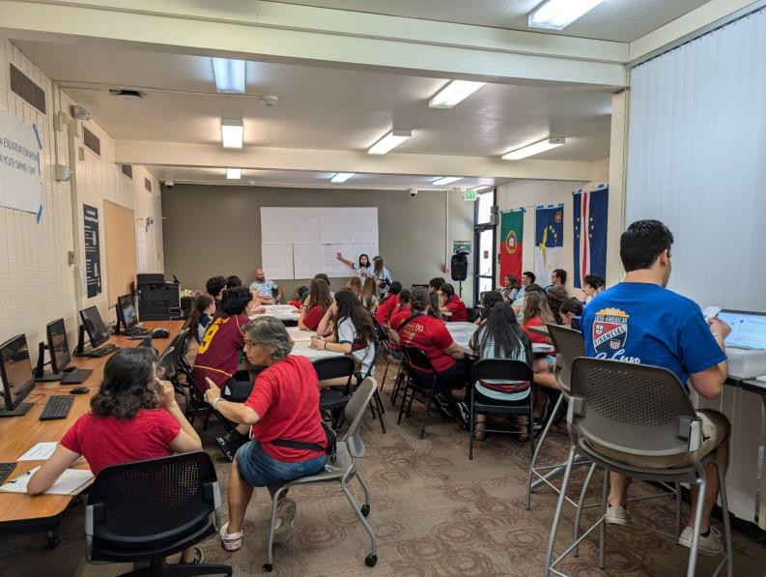
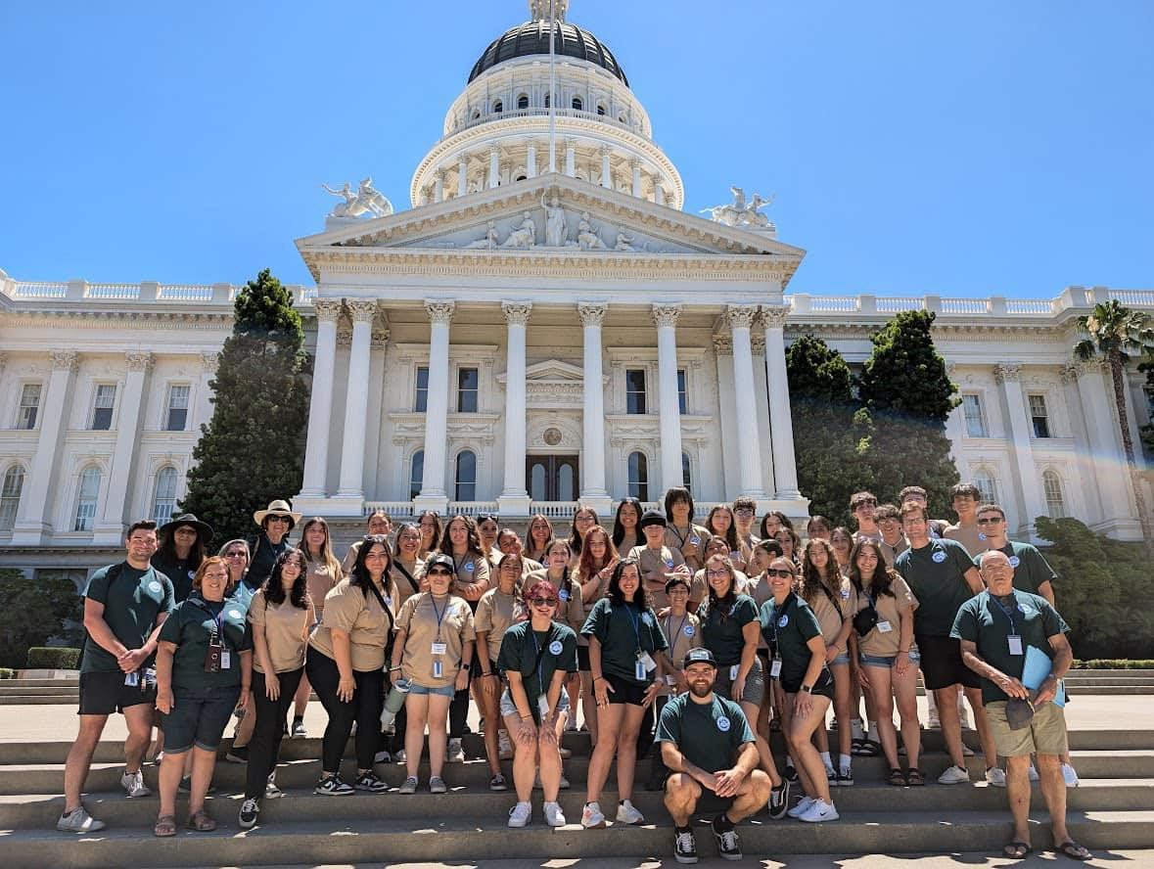
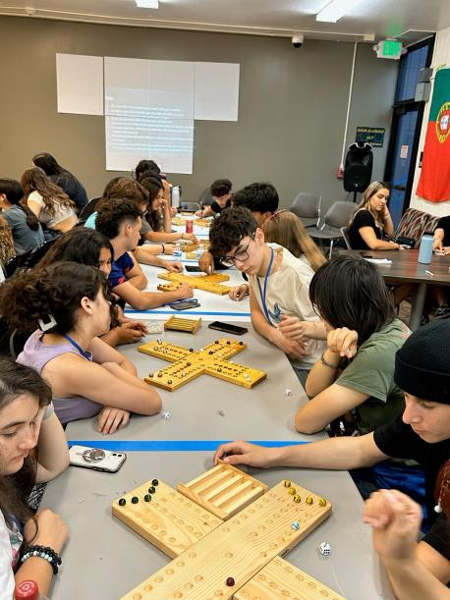
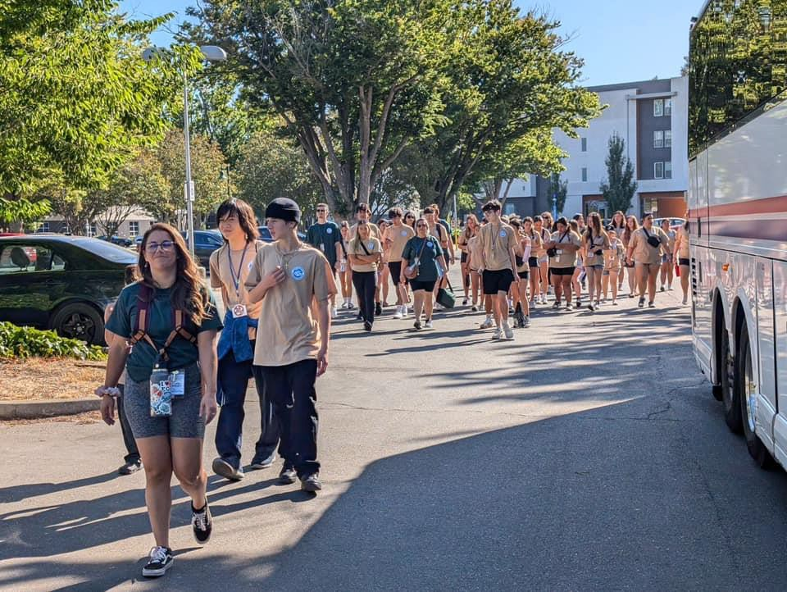
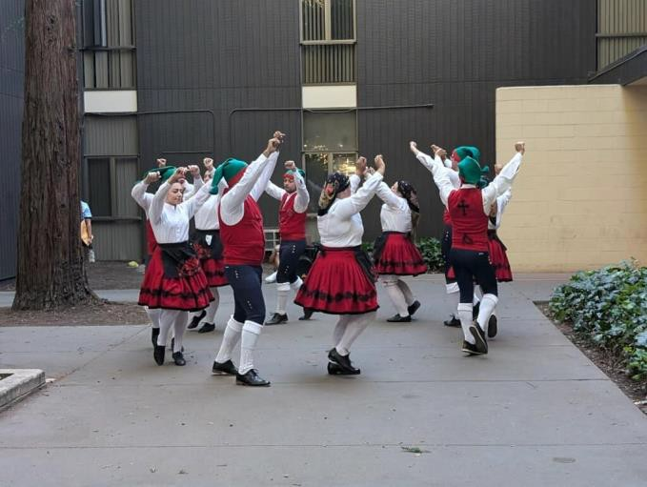
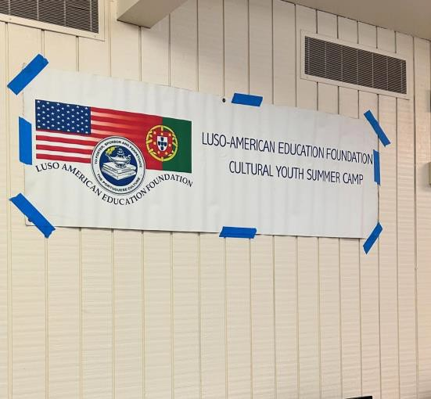
2024 CULTURAL YOUTH SUMMER CAMP
Gary Resendes, Camp Director & Sara Rodrigues, Program Coordinator
June 26 - 30, 2024
California State University, Sacramento

Slide 14
2026 CULTURAL YOUTH SUMMER CAMP
Plans:
Second week of June 2026 at TBD

Slide 15
REPORT ON FUNDRAISING
Brad Angeja
Vice-President of Fundraising

Slide 16
Events 2025

Slide 17
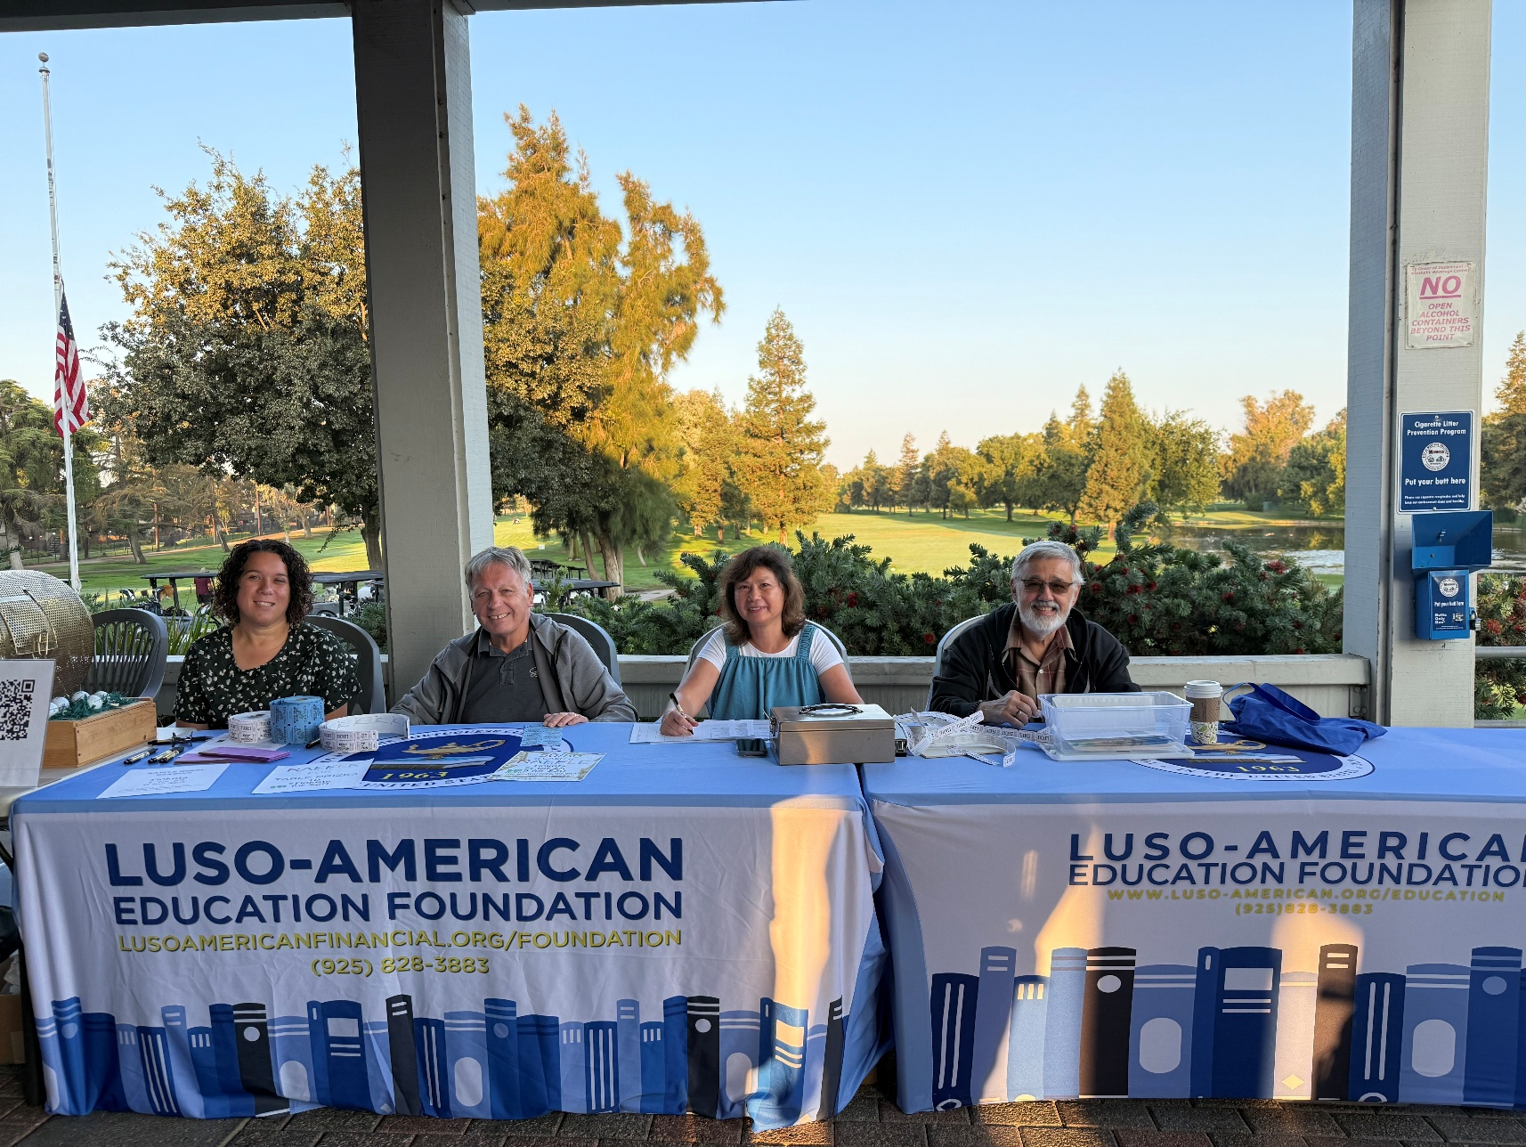
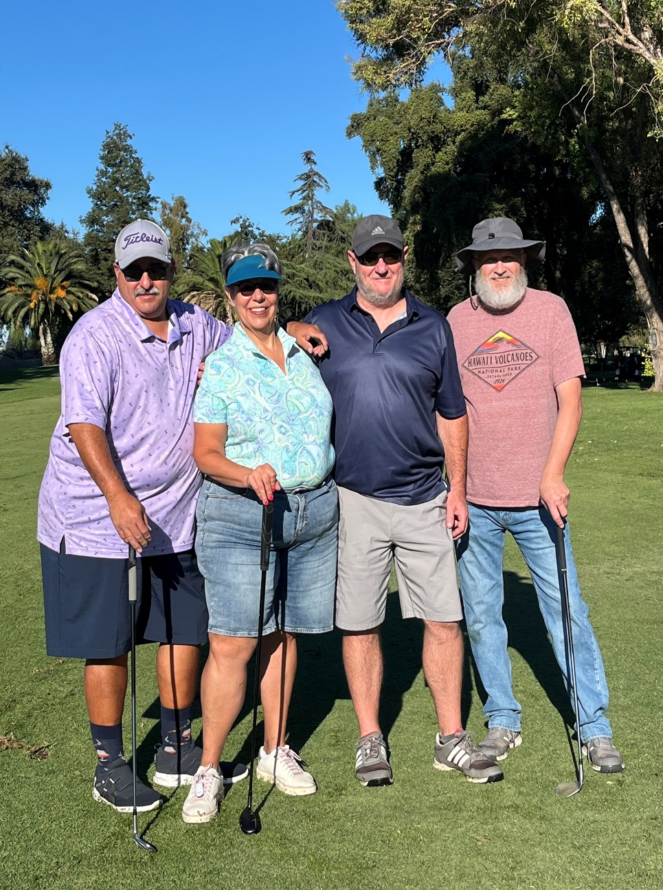
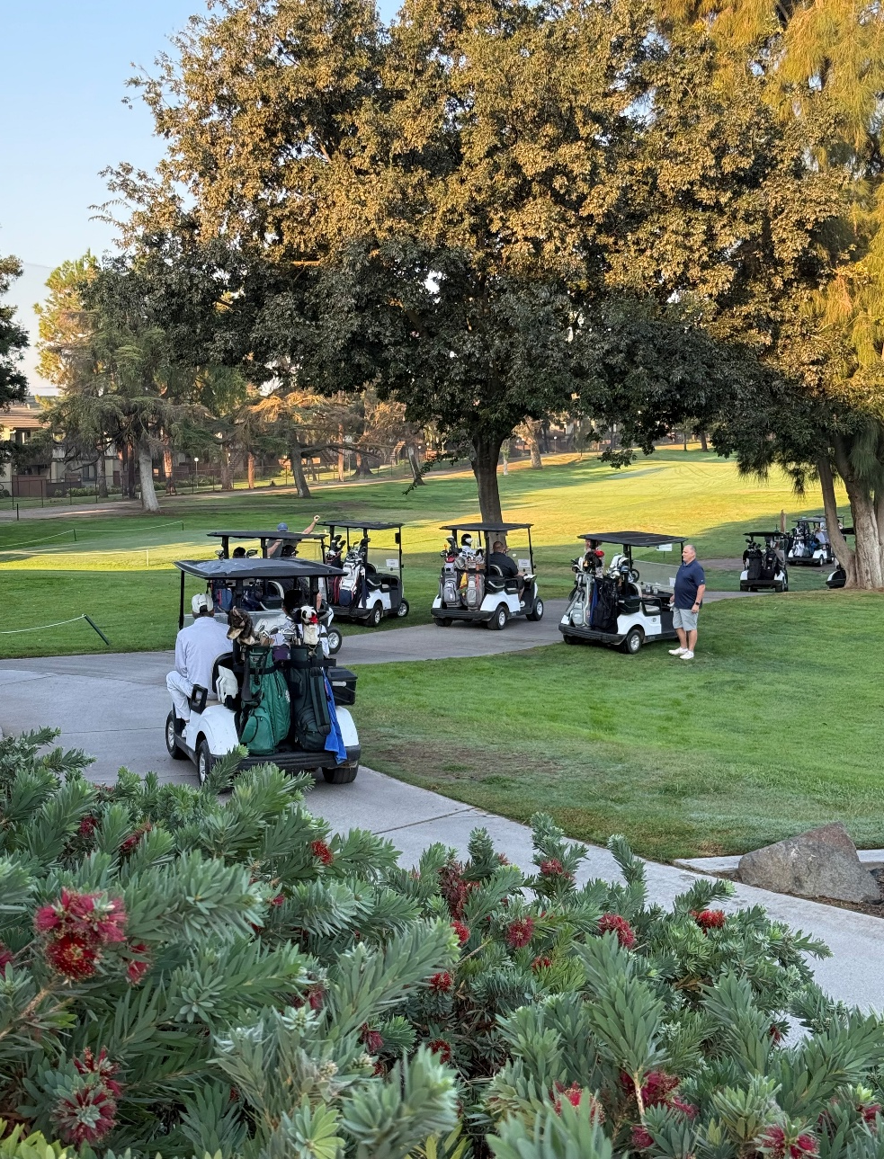

Pelicas-Rosario Golf Fundraiser
Friday, Sept 12, 2025
Manteca Park Golf Course 305 N Union Rd, Manteca

Slide 18
 |  | 2023 | 2024 | 2025
 |  | REDWOOD | MANTECA | MANTECA
 | INCOME:
 | GOLFERS & MEALS | 8,864.78 | 7,140.00 | 8,305.00
 | RAFFLES | 5,885.00 | 3,624.00 | 1,575.00
 | BOOK SALES | 0.00 | 0.00 | ?
 | SPONSORS | 10,193.45 | 16,551.00 | 15,706.00
 | IN MEMORY | 3,646.86 | 3,350.00 | 3,350.00
 | DONATIONS | 3,075.70 | 790.00 | 2,750.00
 | AUCTION | 1,490.00 | 3,895.00 | 5,065.00
 | TOTAL INCOME | 33,845.79 | 35,341.00 | 36,751.00
 | EXPENSES:
 | GOLFERS & MEALS | 6,062.01 | 6,604.29 | 6,994.63
 | PRINTING | 885.12 | 155.89 | 265.00
 | SUPPLIES | 44.08 | 135.92 | 1,050.00
 | COMMITTEE MEETINGS | 90.80 | 0.00 | 0.00
 | TOTAL EXPENSES | 7,082.01 | 6,896.10 | 8,259.63
 | TOTAL NET INCOME | 26,763.78 | 28,444.90 | 28,491.37
Golf Totals with Comparisons
This is our second year at the Manteca Park Golf Course.

Slide 19
2025
2025 GOLF FUNDRAISING TOURNAMENT 9.12.25
INCOME:
GOLF TOURNAMENT - GOLFERS AND MEALS |  | 7,140.00
GOLF TOURNAMENT - RAFFLES |  | 2,665.00
GOLF TOURNAMENT - 50/50 RAFFLE |  | 570.00
GOLF TOURNAMENT - TEAR OFF RAFFLE |  | 380.00
GOLF TOURNAMENT - SPONSORS |  | 16,551.00
GOLF TOURNAMENT - IN MEMORY |  | 3,350.00
GOLF TOURNAMENT - DONATIONS |  | 790.00
GOLF TOURNAMENT - AUCTION |  | 3,895.00
TOTAL INCOME |  |  | 35,341.00
EXPENSES:
GOLF TOURNAMENT- GOLFER & MEALS |  | 6,604.29
GOLF TOURNAMENT- PRINTING |  | 155.89
GOLF TOURNAMENT- SUPPLIES |  | 135.92
TOTAL EXPENSES |  |  | 6,896.10
TOTAL NET INCOME |  |  | 28444.90

Slide 20

2026
Planned Activities

Slide 21

2026
Planned Activities

Slide 22

Save The Date !
Pelicas-Rosario Memorial Golf Tournament 2026
Friday, September 11, 2026
Manteca Park Golf Course
305 N Union Rd Manteca, CA 95337

Slide 23
MEMBERSHIP
REPORT ON
Joseph Resendes
Vice-President of Membership
LAEF Total Active Members
436
5 new members in 2025 from all categories which includes
1 Associate, 2 Individuals, and 1 Family

Slide 24
BREAKDOWN ON MEMBERSHIP
Membership by Type:
Associate Member | 97
Benefactor | 5
Family | 11
Honorary | 4
Individual | 34
Perpetual | 1
Legal Entity | 2
Sponsor | 94
Sustaining | 188
LAEF Total Active Members | 436
Note:
Some of the sponsors and sustaining members have paid off their pledges.
Associate Members are mainly scholarship recipients that are non-paying for 5 years

Slide 25

T R E A S U R E R
REPORT FROM L A E F
Sue Nichols
Luso-American Financial Vice President/Controller

Slide 27
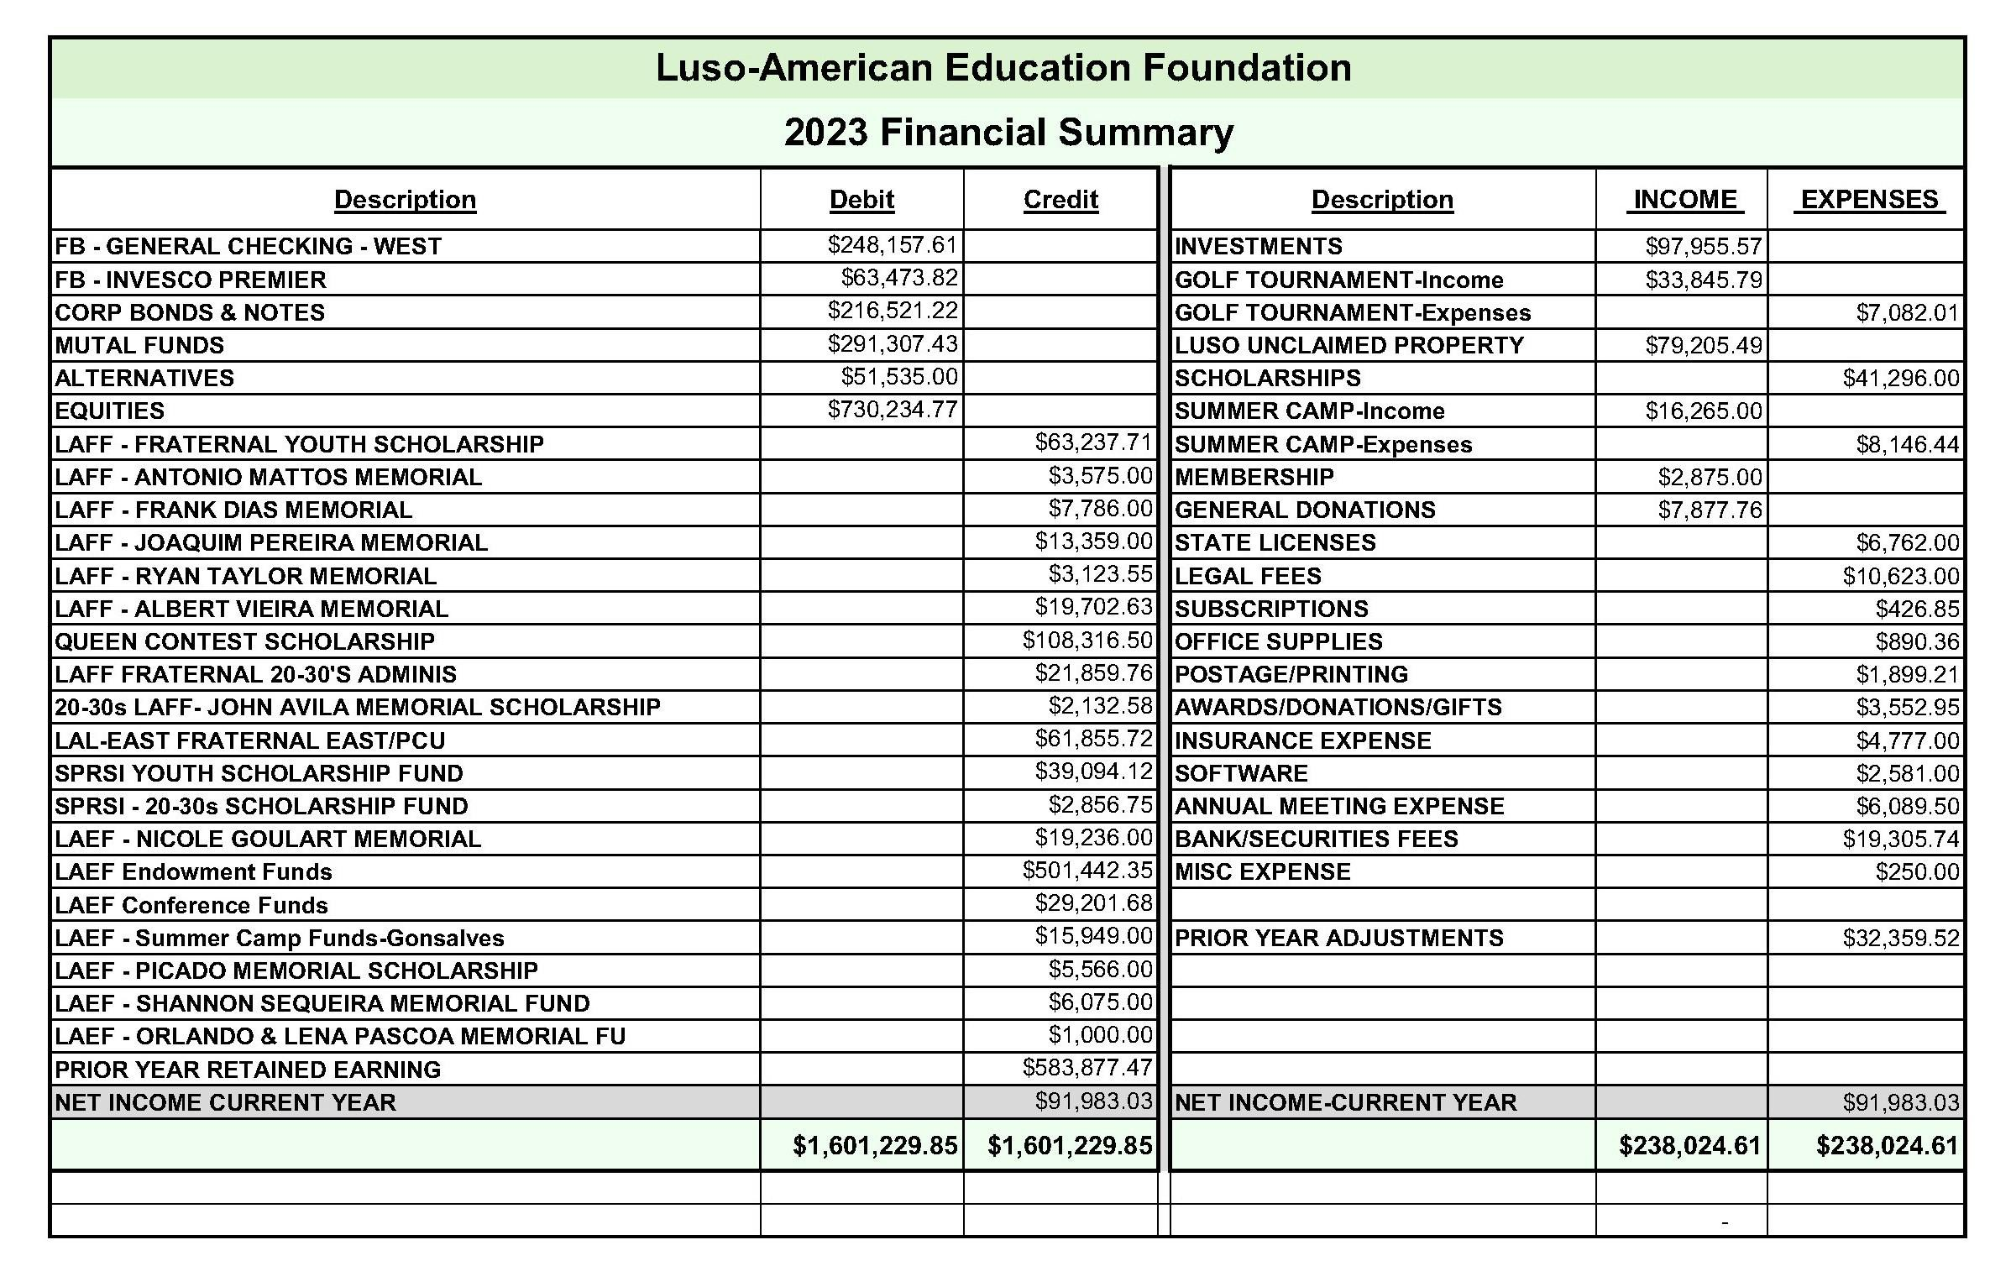
2023 Financial Summary Report

Slide 28
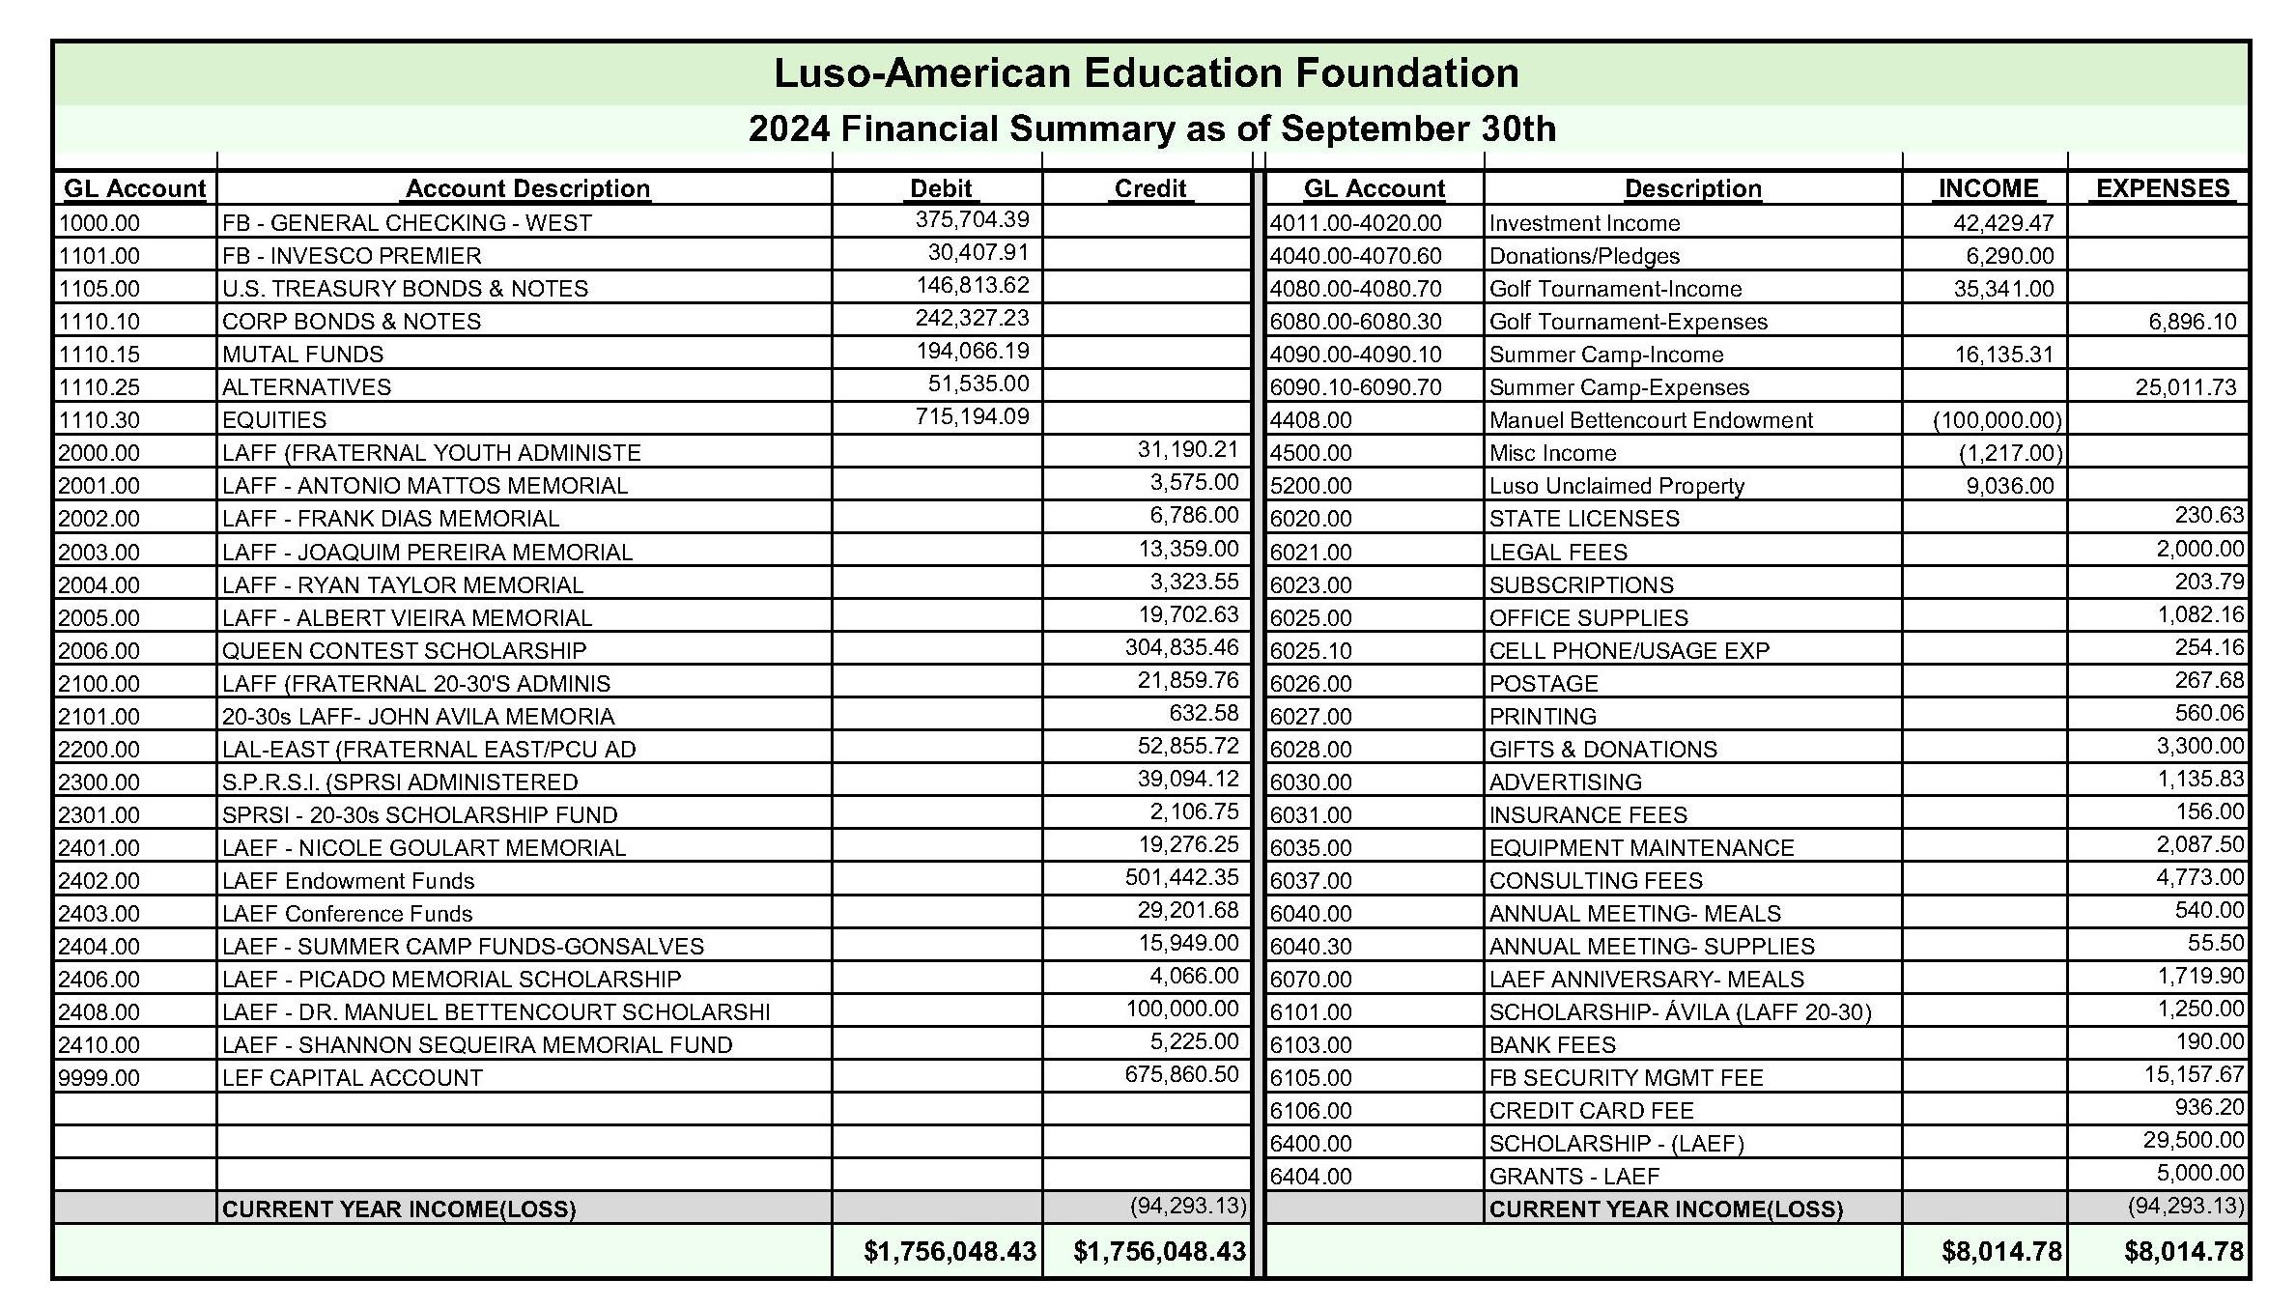
Financial Summary as of XXXXX

Slide 29


REPORT ON ANNUAL CONFERENCE
Nadine Barroca Pursiano
Education Committee Chair
October 2-4, 2025
49th Conference of the Luso-American Education Foundation
A Global Village:
Portugal’s Diaspora as a Fountain of Culture, Memory, Connectivity, and Innovation

Slide 30
49th Conference of the Luso-American Education Foundation
Successfully organized and led by Professor Diniz Borges
Fresno State University, Portuguese Beyond Borders Institute (PBBI)
6th Annual Conference hosted online via Zoom, Facebook, YouTube, and PBBI Fresno State channels
22 hours of engaging presentations, debates and panel discussions
Bilingual sessions: 65% English; 35% Portuguese
Over 15,000 total views across platforms
Opportunities for Growth:
Increase visibility by integrating QR Codes and links through the LAEF website
Encourage donations to support LAEF educational initiatives
Review action items and apply insights from previous conferences to enhance future impact

Slide 31
49th Conference of the LAEF - Demographic Data
AGE RANGE OF VIEWERS
VIEWER LOCATIONS
Other - States Including: CT, FL, HI, MA, NY, TX
Other - International –
Portuguese Speaking: Portugal, Azores, Madeira, Angola, Brazil,Cabo Verde
Other: Bermuda, Canada, France, Germany

Slide 32

A Global Village - Program
Thursday, October 2, 2025
10AM–Opening Ceremonies (bilingual)
Conferência Inaugural: Ecos através dos Oceanos: Memória Cultural na Diáspora
Noon – Do século XVI ao XXI: Luís de Camões vivo e popular
2 PM – Poetry, Stories, Saudade: Artistic Expressions of Diasporic Identity
4 PM – Entre Fusos Horários e Tradições: Memória e Horizonte da Diáspora Portuguesa na América do Norte
6 PM – Sacred Flames, Shared Tables: Portuguese Festas as Bridges of Belonging
8 PM–Homengem a Álamo Oliveira (Gravação dos 75 anos pela Junta de Freguesia do Raminho)
Friday, October 3, 2025
10 AM – Ogygia: Equinoxes of the Written Word (From the mid-Atlantic to North America — a literary bridge built by women)
Noon – Da Preservação à Inovação: A Cultura Açoriana como Ponte entre Comunidades nas Américas
2 PM – Bridges Across the Atlantic: Transnational Ties and Cross-Generational Dialogues (With the Conselheiros das Comunidades Portuguesas – USA/Canada)
4 PM – Portuguese Women in the Diaspora Writing between the lines of saudade and identity
6 PM – Digital Saudade: Technology and the Preservation of Identity and Cultures
8 PM -Homengem a Álamo Oliveira-De mãos dadas com a escrita-VITEC-Azores TV
Saturday, October 4, 2025
8 AM – Bridges of Belonging: How Dual Citizenship Strengthens Diaspora Influence Across the Atlantic
10 AM – Women of the Portuguese Diaspora: Voices of Change and Continuity
Noon – Language, Legacy, and the Next Generation
2 PM – A Caminho dos 50: On the Road to 50 (memories and perspectives) Celebrating the past and present of LAEF as it approaches its golden milestone.
4 PM – Closing Ceremonies (bilingual)
.
Homenagem a Álamo Oliveira – Arquipélagode Escritores.
Special Sessions:
Forty Years, Endless Horizons: FLAD Across the Atlantic Honoring the 40th anniversary of the Luso-American Development Foundation (FLAD),
From the Island to the World: The Living Word of Álamo Oliveira (Da Ilha ao Mundo: A Palavra Viva de Álamo Oliveira)

Slide 33

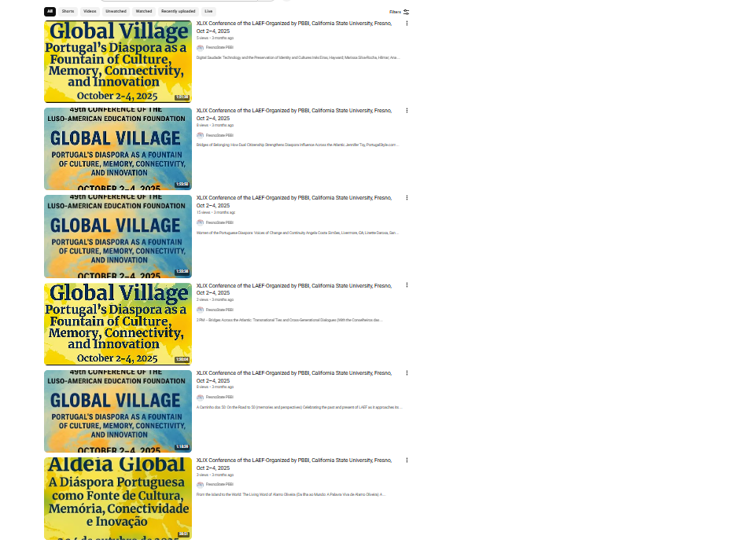
A Global Village – Archived Sessions
STEP 1: SEARCH YouTube© Fresno State
STEP 2: SEARCH XLIX Conference of the LAEF-Organized by PBBI
https://www.youtube.com/results?search_query=Fresno+state+XLIX+conference
STEP 3: SELECT AND VIEW SESSIONS!

Slide 34

Save the date!
September 30th-October 3rd
The 50th Conference on Education and Culture of the Luso-American Education Foundation
Across Five Decades: Creativity, Memory, Autonomy and the Making of Luso-American Communities in North America

Slide 35
Across Five Decades: Creativity, Memory, Autonomy and the Making of Luso-American Communities in North America
Professor Borges will once again use the online format and sessions to
celebrate five decades of Luso-American educational and cultural exchange and the foundational role of LAEF in these efforts
The conference mission includes Building Bridges between:
The diaspora and the continent
Memory and innovation
Education and lived experiences
Local knowledge and global exchange
JOIN US as Diniz invites us to engage in bold, thought-provoking dialogue with scholars, artists, educators, community leaders, entrepreneurs, and cultural workers!

Slide 36
Key Events for the 50th LAEF Conference
Youth Day returns on September 30, hosted in partnership with Fresno State and LAEF
High school outreach initiative, including a campus tour and guest speakers
Opening Session and commemorative gathering celebrating the 50th Conference
Presidential Dinner graciously hosted by the President of Fresno State University in honor of the 50th Anniversary
This celebration will replace the traditional PBBI Annual Dinner
Conference Sessions begin Thursday, October 1st – SAVE THE DATE!

Slide 37
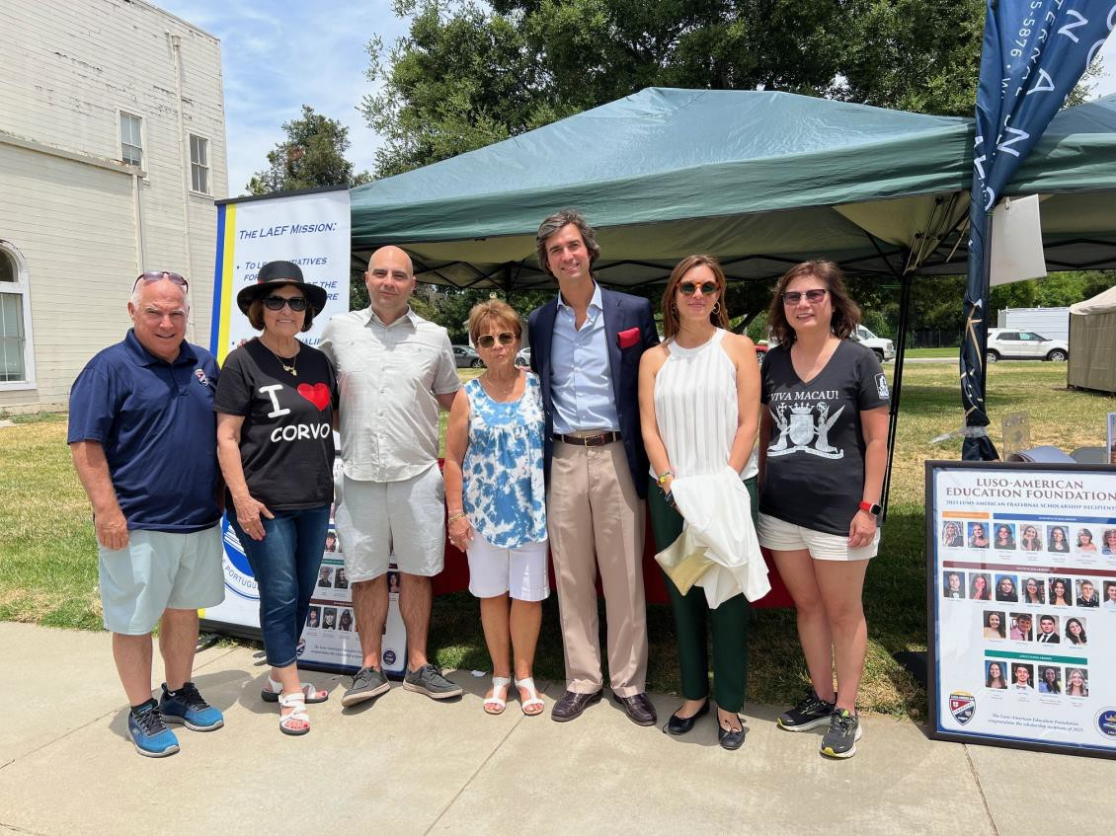
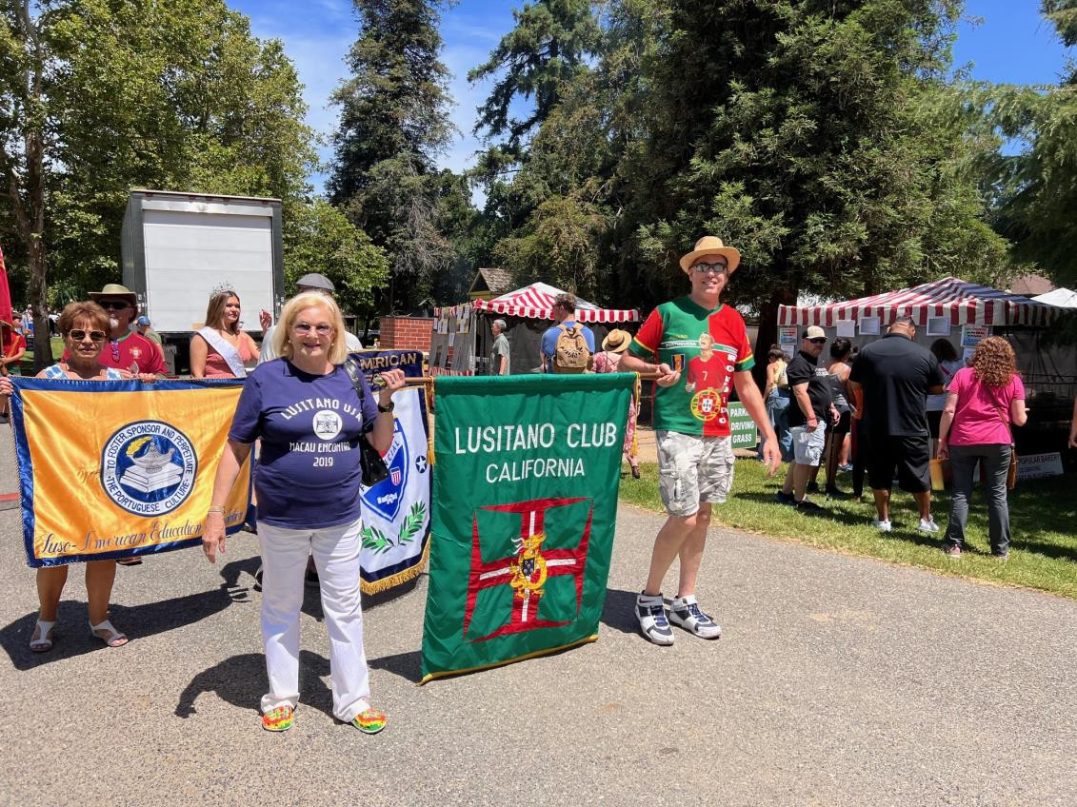

2025 DIA DE PORTUGAL & LAEF ANNIVERSARY
Manuel Bettencourt
LAEF Advisory member Committee Chair
Luso-American Education Foundation
Dia de Portugal - June 8, 2024
Portuguese Historical Museum Dia de Portugal Festival, San Jose

Slide 38
2026 DIA DE PORTUGAL
Save The Date
Saturday, June 13th 2026
History Park, San Jose
10:00AM

Slide 39
2024 CULTURAL YOUTH SUMMER CAMP
Gary Resendes, Camp Director & Sara Rodrigues, Program Coordinator
June 26 - 30, 2024
California State University, Sacramento

Slide 40
2024 CULTURAL YOUTH SUMMER CAMP
2024 Summer Camp Financial Report
RECEIVABLES
REGISTRATION (34 campers) |  | $ 15,450.00
Donations |  | $ 685.31
Gonsalves Trust |  | $ 1,000.00
TOTAL INCOME |  | $ 17,135.31
EXPENSES
COLLEGE - ROOMING, MEALS, PARKING, BUS |  | $ 13,071.60
SUPPLIES - T-SHIRTS, SEMINAR SUPPLIES, BACKGROUND CHECK |  | $ 3,525.13
FIELD TRIP |  | $ 1,665.00
FOLK DANCE GROUP |  | $ 250.00
STAFF STIPEND |  | $ 6,500.00
TOTAL EXPENSES |  | $ 25,011.73
NET COST paid by LAEF
$
7,876.42

Slide 41

June 26 -30, 2024
Cultural Youth Summer Camp Program:
A Força da Nossa Gente - The Strength of our People

Slide 42
2026 CULTURAL YOUTH SUMMER CAMP
Plans:
Second week of June 2026 at XXXX

Slide 43
Resolution 01-25
REPORT FROM THE RESOLUTION COMMITTEE
Resolved, that this meeting, due now, proceed to the election of Directors to serve for their ensuing terms and until their successor are elected and qualified.
Resolution 02-25
Resolved, that all acts and transactions of the Board of Directors, Executive Committee and Officers of this Foundation since the annual meeting which was on January 28, 2024 to the date hereof, all of which are known to us, be and are hereby, approved and confirmed as the acts of the Foundation.
Resolution Committee signed and dated the resolutions above.
January 18, 2025

Slide 44
Adjournment
THANK YOU TO ALL WHO ATTENDED
AND PARTICIPATED IN TODAY’S
ANNUAL MEETING. STAY SAFE!

